Slide 2
Data Structure Definitions
# a Party is a location, theme, and number of guests
data Party:
| party(location :: String,
theme :: String,
guests :: Number)
end

Slide 3
Data Structure Definitions
# a Party is a location, theme, and number of guests
data Party:
| party(location :: String,
theme :: String,
guests :: Number)
end
define a new type of data

Slide 4
Data Structure Definitions
# a Party is a location, theme, and number of guests
data Party:
| party(location :: String,
theme :: String,
guests :: Number)
end
the name of the new data type

Slide 5
Data Structure Definitions
# a Party is a location, theme, and number of guests
data Party:
| party(location :: String,
theme :: String,
guests :: Number)
end
the name of the function that can produce this type of data

Slide 6
Data Structure Definitions
# a Party is a location, theme, and number of guests
data Party:
| party(location :: String,
theme :: String,
guests :: Number)
end
the names of parameters that make up the data

Slide 7
Data Structure Definitions
# a Party is a location, theme, and number of guests
data Party:
| party(location :: String,
theme :: String,
guests :: Number)
end
the types of data of the individual parameters

Slide 8
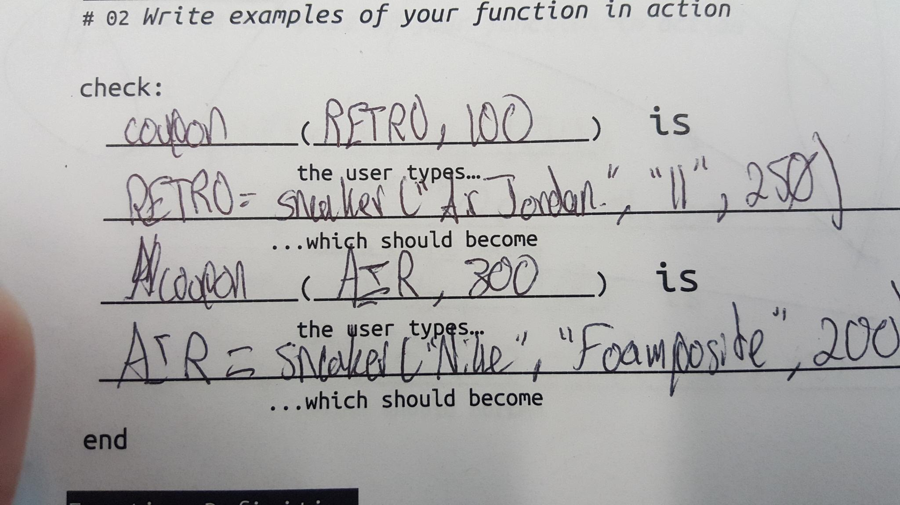

Slide 9
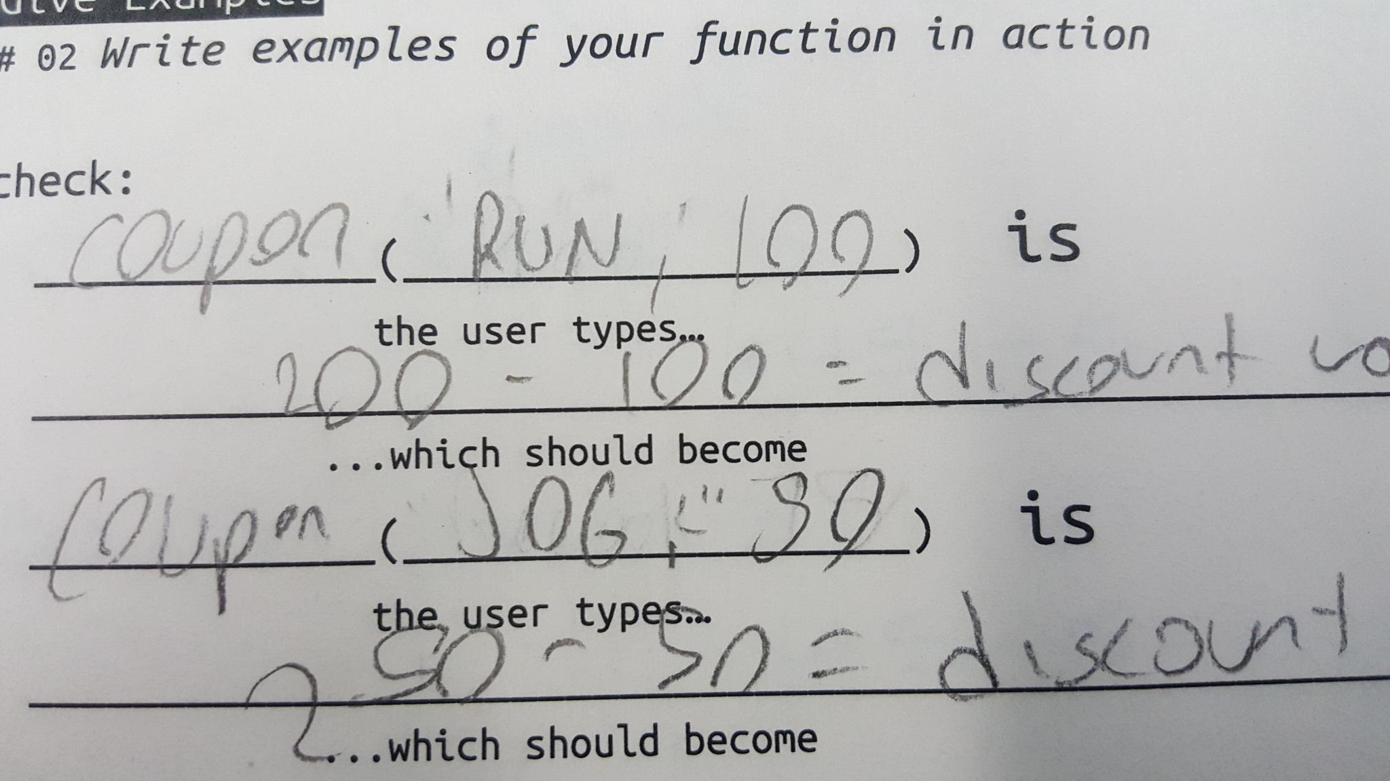

Slide 10
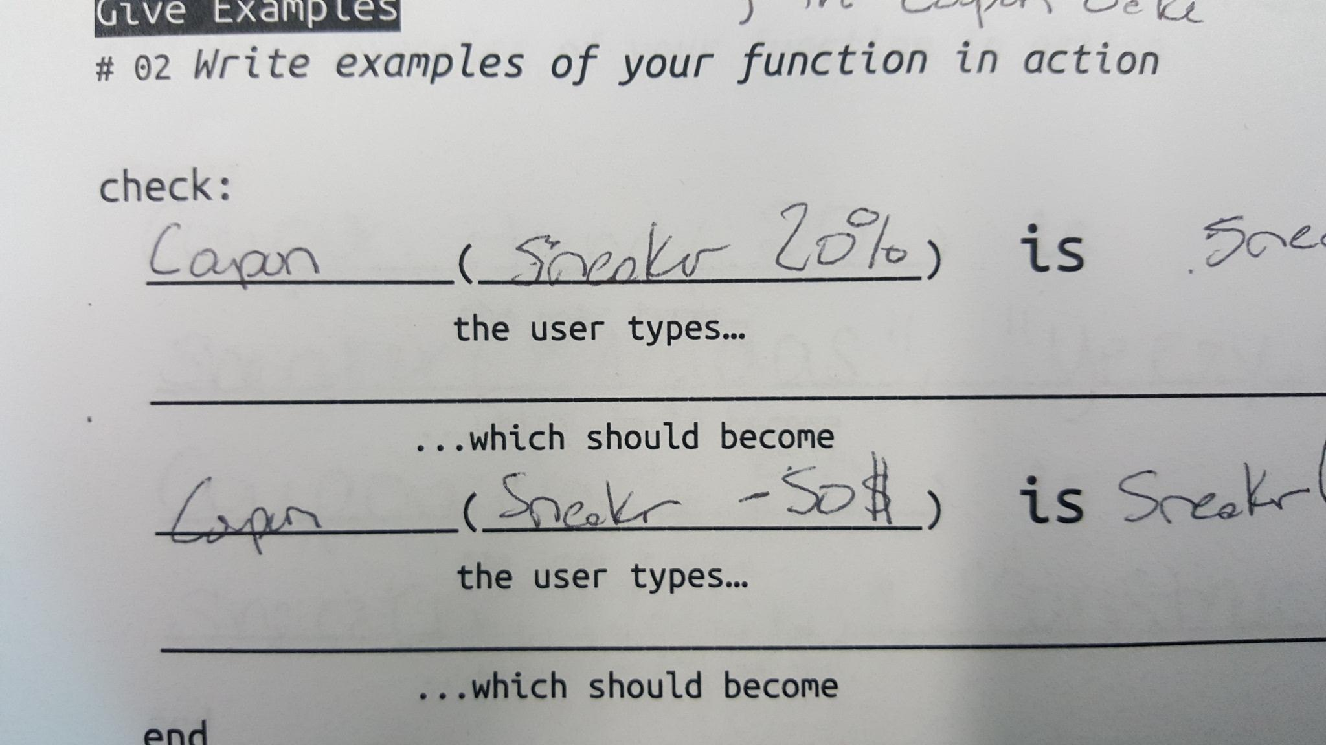

Slide 11
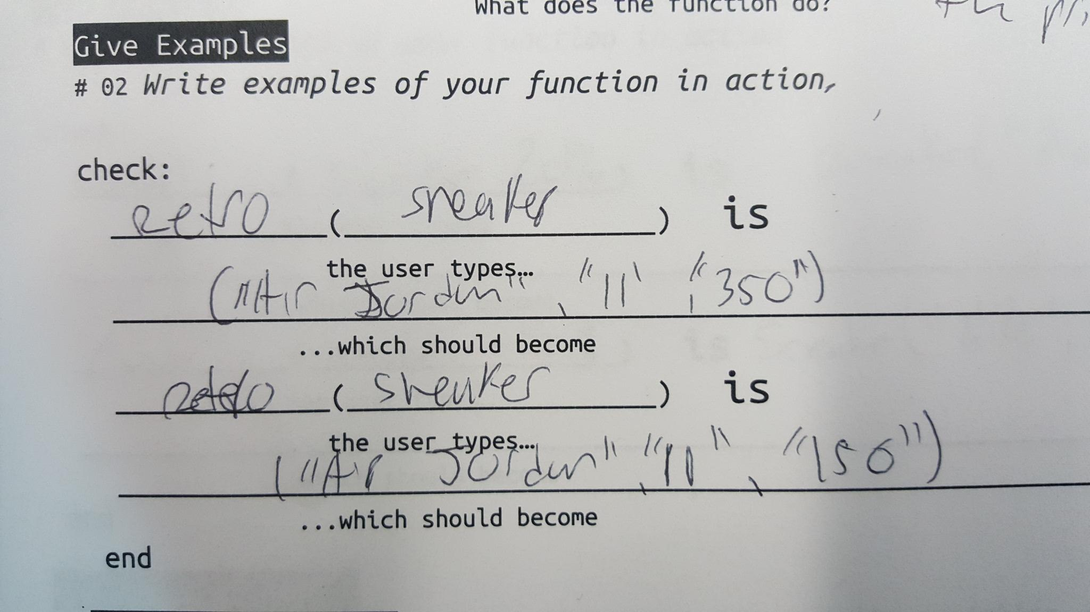

Slide 12
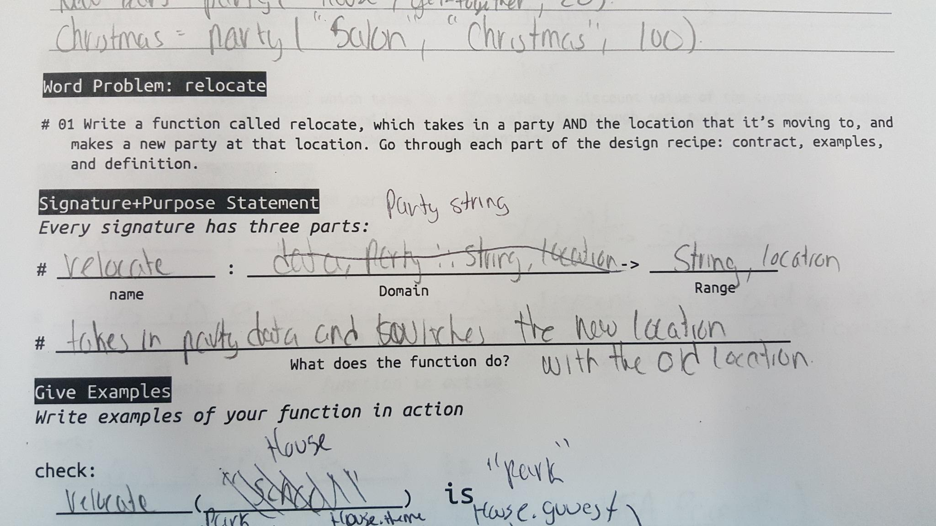

Slide 13
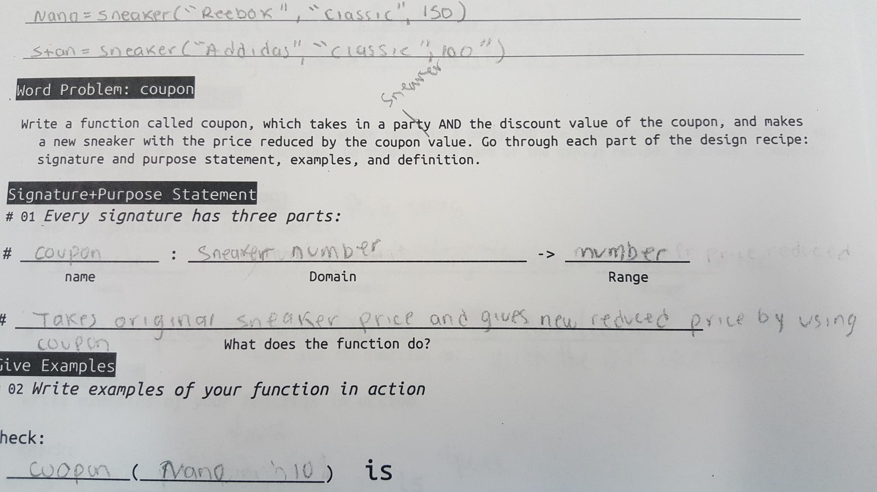

Slide 14
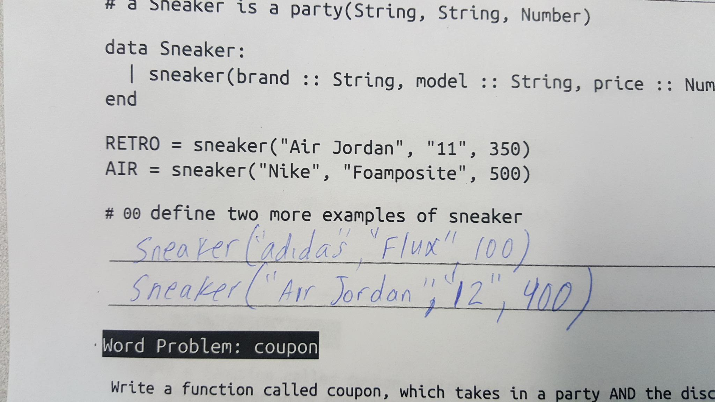

Slide 15
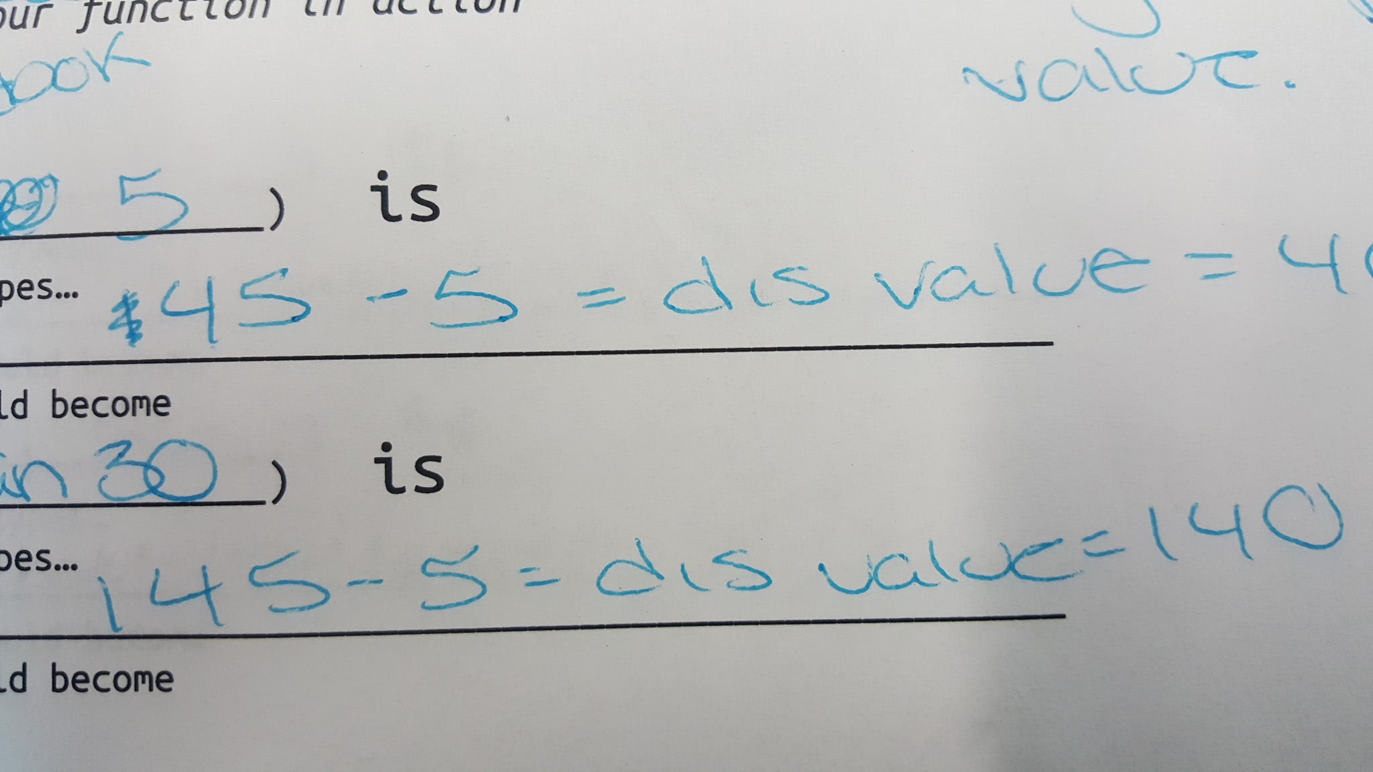

Slide 16
